Slide 1
CEG 4424/6424 Final Exam Review
Meilin Liu

Slide 2
Final Exam Time and Location
All students will take the online exam.
the exam will be available for checking out from 10:00 am – 10:00 pm Dec. 10th, 2025
You will have 120 minutes to work on the exam.

Slide 3
Policy
This is a close-book final exam
Students are allowed to carry a cheat sheet hand-written on a 4' by 6' note card (double sides)
Calculators with basic operation support (+/-/*/division) are permitted
You have totally 120 minutes.
You are not allowed to collaborate with other students during the exam
No aid given, received, or observed.
You will be given credits only for what appears in your submission.

Slide 4
Policy (Cont.)
Students should never share questions or answers of the exam paper with other students.

Slide 5
Questions
Questions
True/False
Filling blanks
Multiple choices
Short questions
Computation questions

Slide 6
Topics
Software Security, BOF
OS Security
Introduction to Networking
Network Security
SYN Flood Attack
SYN cookies
Forged RST packets
DNS poisoning attack
0x20 Encoding
Intrusion Detection
Misuse Detection
Anomaly Detection
Signature Generation
Cyber Physical System
Risk Management
Web Security

Slide 7
BOF - An Example
main:
XXX
YYY # instrs for printf
#include <string.h>
int main (int argc, char **argv)
{
printf(“%s”, “CEG”);
foo(argv[1]);
printf(“%s”, “7900”)
}
void foo (char *bar)
{
char c[12];
strcpy (c, bar); //no bound
}
OS Kernel
push argv[1]
call foo #EIP will be pushed
Text
ZZZ
KKK # instrs for printf
Data
foo:
push EBP
mov ESP, EBP
sub 12 ESP #Allocate buffer
copy data
mov EBP ESP
pop EBP
ret
Heap
Stack
Source code in C
The executable illustrated
using assembly code
Memory layout
Notes:
Ask students which instructions will affect the stack?
: exec( “/bin/sh” )

Slide 8
BOF - An Example
#include <string.h>
int main (int argc, char **argv)
{
printf(“%s”, “CEG”);
foo(argv[1]);
printf(“%s”, “7900”)
}
void foo (char *bar)
{
char c[12];
strcpy (c, bar);
}
XXX
YYY # instrs for printf
push argv[1]
call foo #EIP will be pushed
pop
adr1
ZZZ
KKK #instrs for printf
foo:
push EBP
mov ESP, EBP
sub 12 ESP #Allocate buffer
copy data
mov EBP ESP
pop EBP
ret
main func’s
frame
ESP
EBP
Notes:
Ret: picks up the EIP stored in the stack and then execuate
After ‘gcc –S –o stack.s stack.c’
See notes below

Slide 9
BOF - An Example
#include <string.h>
int main (int argc, char **argv)
{
printf(“%s”, “CEG”);
foo(argv[1]);
printf(“%s”, “7900”)
}
void foo (char *bar)
{
char c[12];
strcpy (c, bar);
}
XXX
YYY # instrs for printf
c[0]
ESP
push argv[1]
call foo #EIP will be pushed
pop
c[1]
Buffer for
12 chars
adr1
ZZZ
KKK #instrs for printf
c[11]
EBP
EBP
foo:
push EBP
mov ESP, EBP
sub 12 ESP #Allocate buffer
copy data
mov EBP ESP
pop EBP
ret
EIP(adr1)
argv[1]
main func’s
frame
Notes:
Ret: picks up the EIP stored in the stack and then execuate
After ‘gcc –S –o stack.s stack.c’
See notes below

Slide 10
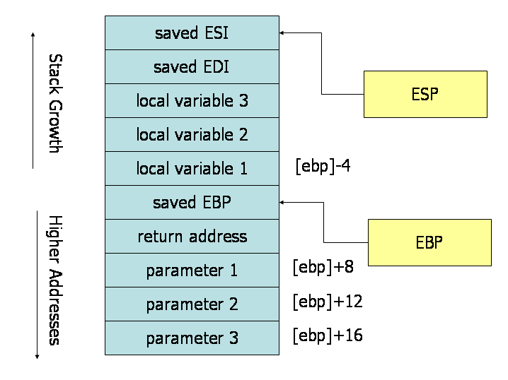
A snapshot of the stack frame
int foo (int arg1, int arg2, int arg3) ;
https://flint.cs.yale.edu/cs421/papers/x86-asm/asm.html

Slide 11
BOF - An Example
#include <string.h>
int main (int argc, char **argv)
{
printf(“%s”, “CEG”);
foo(argv[1]);
printf(“%s”, “7900”)
}
void foo (char *bar)
{
char c[12];
strcpy (c, bar);
}
./test “abcdef87654”
XXX
YYY # instrs for printf
‘a’
ESP
push argv[1]
call foo #EIP will be pushed
pop
‘b’
Buffer for
12 chars
adr1
ZZZ
KKK #instrs for printf
‘\0’
EBP
EBP
foo:
push EBP
mov ESP, EBP
sub 12 ESP #Allocate buffer
copy data
mov EBP ESP
pop EBP
ret
EIP(adr1)
argv[1]
main func’s
frame
Notes:
Ret: picks up the EIP stored in the stack and then execuate
After ‘gcc –S –o stack.s stack.c’
See notes below

Slide 12
BOF - An Example
#include <string.h>
int main (int argc, char **argv)
{
printf(“%s”, “CEG”);
foo(argv[1]);
printf(“%s”, “7900”)
}
void foo (char *bar)
{
char c[12];
strcpy (c, bar);
}
./test “abcdef1234876543”
XXX
YYY # instrs for printf
‘a’
ESP
push argv[1]
call foo #EIP will be pushed
pop
‘b’
Buffer for
12 chars
adr1
ZZZ
KKK #instrs for printf
‘7’
‘3’
EBP
EBP
foo:
push EBP
mov ESP, EBP
sub 12 ESP #Allocate buffer
copy data
mov EBP ESP
pop EBP
ret
‘\0’
EIP(adr1)
argv[1]
main func’s
frame
Notes:
Ret: picks up the EIP stored in the stack and then execuate
After ‘gcc –S –o stack.s stack.c’
See notes below

Slide 13
BOF - An Example
#include <string.h>
int main (int argc, char **argv)
{
printf(“%s”, “CEG”);
foo(argv[1]);
printf(“%s”, “7900”)
}
void foo (char *bar)
{
char c[12];
strcpy (c, bar);
}
./test “abcdef1234876543”
XXX
YYY # instrs for printf
‘a’
push argv[1]
call foo #EIP will be pushed
pop
‘b’
Buffer for
12 chars
adr1
ZZZ
KKK #instrs for printf
‘4’
‘3’
EBP
foo:
push EBP
mov ESP, EBP
sub 12 ESP #Allocate buffer
copy data
mov EBP ESP
pop EBP
ret
‘\0’
EIP(adr1)
ESP
argv[1]
main func’s
frame
Faults
Ox0000
Notes:
Ret: picks up the EIP stored in the stack and then execuate
After ‘gcc –S –o stack.s stack.c’
See notes below

Slide 14
BOF - An Example
#include <string.h>
int main (int argc, char **argv)
{
printf(“%s”, “CEG”);
foo(argv[1]);
printf(“%s”, “7900”)
}
void foo (char *bar)
{
char c[12];
strcpy (c, bar);
}
./test “0xFF223……..”
XXX
YYY # instrs for printf
0xABCD
Malicious
Instructions
(shellcode)
push argv[1]
call foo #EIP will be pushed
pop
Buffer for
12 chars
adr1
ZZZ
KKK #instrs for printf
EBP
foo:
push EBP
mov ESP, EBP
sub 12 ESP #Allocate buffer
copy data
mov EBP ESP
pop EBP
ret
EIP(adr1)
0xABCD
argv[1]
Previous func’s
frame
ESP
EBP
Notes:
exec( “/bin/sh” )
After ‘gcc –S –o stack.s stack.c’
See notes below

Slide 15
BOF - An Example
#include <string.h>
int main (int argc, char **argv)
{
printf(“%s”, “CEG”);
foo(argv[1]);
printf(“%s”, “7900”)
}
void foo (char *bar)
{
char c[12];
strcpy (c, bar);
}
Pad shellcode with NOPs.
./test “0xFF223……..”
XXX
YYY # instrs for printf
0xABCD
Malicious
Instructions
(shellcode)
push argv[1]
call foo #EIP will be pushed
pop
Buffer for
12 chars
adr1
ZZZ
KKK #instrs for printf
EBP
foo:
push EBP
mov ESP, EBP
sub 12 ESP #Allocate buffer
copy data
mov EBP ESP
pop EBP
ret
EIP(adr1)
0xABCD
argv[1]
Previous func’s
frame
ESP
EBP
Notes:
After ‘gcc –S –o stack.s stack.c’
See notes below

Slide 16
Pad Shellcode with NOPs
NOP
NOP
…..
NOP
As long as the overwritten return address (EIP’) hits one of the NOP instructions, the shellcode will be executed.
Shellcode
EIP’
argv[1]
main func’s
frame

Slide 17
BOF - Defenses
Marking stack as non-execute
Stack Guard
Address Space Layout Randomization (ASLR)
Instruction Set Randomization (ISR)

Slide 18
A snapshot of the stack frame
int foo (int arg1, int arg2, int arg3) ;
Note: In the stack frame for a function, the order and the location of the input parameters, and the local variables, will depend on the programming language and the compiler used, and the target machine Architecture.
Compiler: gcc
Language: c language
Machine architecture: intel x86 architecture
Note: In the stack frame for a function, the order and the location of the input parameters, and the local variables, will depend on the programming language and the compiler used, and the target machine Architecture.
https://flint.cs.yale.edu/cs421/papers/x86-asm/asm.html

Slide 19
A snapshot of the stack frame: An Example
int foo(int a, int b, int c)
{
int x, y, z;
x = a + 5;
y = b - 3;
z = c * 2;
return 0;
}
Stack Frame Layout:
Lower address of memory
=============
z
y
x
EBP
EIP (return address)
a
b
c
=================
Higher address of memory
Compiler: gcc
Language: c language
Machine architecture: intel x86 architecture
Note: In the stack frame for a function, the order and the location of the input parameters, and the local variables, will depend on the programming language and the compiler used, and the target machine Architecture.
Notes:
gcc stack.c –S –o stack.s

Slide 20
What Security Goals Does Operating System Provide?
More recent past and present: Networked desktop computers: ensure secure operation in networked environment
New threat?
Attackers coming from the network. Network-facing programs on computers may be buggy. Users may be hurt via online communication.
Security mechanisms
Authentication; Access Control
Secure Communication (using cryptography)
Logging & Auditing
Intrusion Prevention and Detection
Recovery
Notes:
Threat model: adversaries control the network; can communicate with computers;
Security Goal: Confidentiality, Integrity, Availability
Principle of Complete Mediation: All accesses to objects be checked to ensure that they are allowed.
Principle of Separation of Privilege: A system should not grant permission based on a single condition.

Slide 21
User-Land vs. Kernel-Land
User
Applications
Userland
Non-Essential
OS Applications
Operating
Systems
The OS Kernel
CPU, Memory,
Input/Output
Hardware
Notes:
Briefly review some terminology used throughout the course.

Slide 22
High-level View of Kernel Space vs. User Space
……
Process 1
Process 2
Process n
The Kernel
Hardware (disks, network interfaces, etc.)

Slide 23
Access control
A reference monitor mediates all access to resources
Principle: Complete mediation: control all accesses to resources
Reference
monitor
?
Resource
User process
access request
policy
Notes:
System call gates actually perform access control.
Principle of Complete Mediation: All accesses to objects be checked to ensure that they are allowed.
Principle of Separation of Privilege: A system should not grant permission based on a single condition.

Slide 24
Access Control Matrix
Subjects (users) index the rows
Objects (resources) index the columns
Accounting
program
Accounting
data
Insurance
data
Payroll
data
OS
rx | rx | r | --- | ---
rx | rx | r | rw | rw
rwx | rwx | r | rw | rw
rx | rx | rw | rw | rw
Bob
Alice
Sam
Accounting
program

Slide 25
Access Control Lists (ACLs)
ACL: store access control matrix by column
Example: ACL for insurance data is in blue
Accounting
program
Accounting
data
Insurance
data
Payroll
data
OS
rx | rx | r | --- | ---
rx | rx | r | rw | rw
rwx | rwx | r | rw | rw
rx | rx | rw | rw | rw
Bob
Alice
Sam
Accounting
program

Slide 26
Access Control Lists (ACLs)
ACL: store access control matrix by column
Example: ACL for insurance data is in blue
Insurance data:
(Bob, ---), (Alice, rw), (Sam, rw), (accounting program, rw)

Slide 27
Capabilities (or C-Lists)
Store access control matrix by row
Example: Capability for Alice is in red
Accounting
program
Accounting
data
Insurance
data
Payroll
data
OS
rx | rx | r | --- | ---
rx | rx | r | rw | rw
rwx | rwx | r | rw | rw
rx | rx | rw | rw | rw
Bob
Alice
Sam
Accounting
program

Slide 28
Capabilities (or C-Lists)
Store access control matrix by row
Example: Capability for Alice is in red
Alice: (OS, rx), (accounting program, rx), (accounting data, r),
(insurance data, rw), (payroll data, rw).

Slide 29
TCP/IP suite
Physical Layer: To transmission bits over a media
Data Link Layer: transferring datagram from one node to physically adjacent node over a link, using MAC (Medium Access Control) address
Network Layer: To move packets from source to destination
TCP layer: provides a message delivery between two hosts (two processes), error control
Application Layer: handles the details of the particular application, using TCP/IP suite
The data is sent down the protocol stack
Each layer adds to the data by prepending headers
application
transport
network
Data link
physical
Notes:
Physical Layer: Coaxial cable, Optical fiber, Wireless communications
Data Link Layer: transferring datagram from one node to physically adjacent node over a link, using MAC address, includes device driver and network interface card
IP (Internet Protocol): To move packets from source to destination, using IP address
TCP layer (Transmission Control Protocol): provides a reliable flow of data between two hosts
Application Layer: handles the details of the particular application, using TCP/IP suite, FTP, HTTP, Web service, SMTP
MTU: Maximum transmission unit: a 1500-byte packet, the largest allowed by Ethernet at the network layer
The data is sent down the protocol stack
Each layer adds to the data by prepending headers
MTU: Maximum Transmission Unit

Slide 30
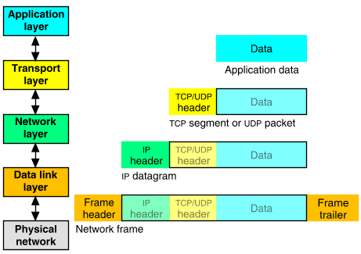
Packet Encapsulation
The data is sent down the protocol stack
Each layer adds to the data by prepending headers
22Bytes
20Bytes
20Bytes
4Bytes
64 to 1500 Bytes
Notes:
User Datagram Protocol (UDP): With UDP, computer applications can send messages, in this case referred to as datagrams, to other hosts on an Internet Protocol (IP) network. Prior communications are not required in order to set up communication channels or data paths.

Slide 31
The TCP 3-Way Handshake
Client (IP1, Port1)
Server (IP2, Port2)
SYN (seq=x)
Listening
Initialize a data structure in the memory
SYN ACK (ack=x+1 seq=y)
(IP1, Port1, TCP, Seq, AcK, …)
Wait
ACK (ack=y+1,seq=x+1)
Connected
Update the data structure

Slide 32


SYN Flood Attack
Memory Filled Up!
IP1
IP2, port1, IP, Port, SYN
IP, Port
IP3, port3, IP, Port, SYN
……
IP4, port4, IP, Port, SYN
Server
IPN, …….., IP, Port, SYN
Spoofed Source IP addresses
Notes:
Two disadvantages:
IP1 is bad
Only 2^16 connections

Slide 33
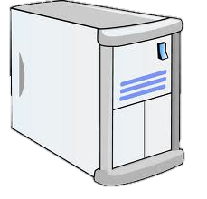

Distributed SYN Flood Attack
Rnd_IP, Rnd_Port, IP, Port, SYN
Memory Filled Up!
IP, Port
……

Slide 34
SYN Cookies
General idea
Delay the initialization of the data structure to the third packet in the 3-way handshake
Client (IP1, Port1)
Server (IP2, Port2)
Client (IP1, Port1)
Server (IP2, Port2)
SYN (seq=x)
SYN (seq=x)
(IP1, Port1, TCP, Seq, Ack, …)
SYN-ACK
(ack=x+1 seq=y)
SYN-ACK
(ack=x+1 seq=y)
ACK
(ack=y+1,seq=x+1)
ACK
(ack=y+1,seq=x+1)
(IP1, Port1, TCP, Seq, Ack, …)
Notes:
For the second picture, an attacker can send send a fake ACK message to the server.
How does the server know:
The client has sent the SYN packet in the first place.
The client has successfully received the SYN-ACK packet?

Slide 35
SYN Cookies
Client (IP1, Port1)
Server (IP2, Port2)
SYN (seq=x)
SYN-ACK
(ack=x+1 seq=y)
t mod 32
MSS
Cookie=HMAC(t, N_{s}, SIP, SPort, DIP, DPort)
5 bits
3 bits
t mod 32: t is a slowly increasing timestamp maintained by the server, ensuring sequence numbers increase every 64 seconds
MSS: encoding of server MSS (maximum segment size)
Cookie: easy to create and validate, hard to forge
No resource is invested in the server side to maintain the state of this connection!!
Notes:
For the second picture, an attacker can send send a fake ACK message to the server.
How does the server know:
The client has sent the SYN packet in the first place.
The client has successfully received the SYN-ACK packet?

Slide 36
SYN Cookies
Server (IP2, Port2)
Client (IP1, Port1)
ACK
(ack=K, seq=D)
K – 1
5 bits
3 bits
24 bits
Equal to “t mod 5”?
Equal to HMAC(t,N_{s},SIP,Sport,DIP,Dport)?
(IP1, Port1, TCP, Seq, Ack, …)
Resource is invested in the server side to maintain the state of this connection if “YES” for both questions.
Notes:
For the second picture, an attacker can send send a fake ACK message to the server.
How does the server know:
The client has sent the SYN packet in the first place.
The client has successfully received the SYN-ACK packet?

Slide 37

Malicious Usage: RST Reset
SYN (seq=x)
SYN ACK (ack=x+1 seq=y)
SYN ACK (ack=x+1 seq=y)
ACK (ack=y+1,seq=x+1)
Client (C)
Server
RST (Src Server)
RST (Src Client)
Sniff
Inject
Attacker (inline)

Slide 38
How DNS Works
Root server
“.com” server IP?
Recursive
DNS server
Y.Y.Y.Y
com server
(IP: Y.Y.Y.Y)
cash.foo.com
“foo.com” server IP?
Z.Z.Z.Z
cash.foo.com: X.X.X.X
foo.com: Z.Z.Z.Z
“cash.foo.com” IP?
foo server
(IP: Z.Z.Z.Z)
cash.foo.com: X.X.X.X
foo.com: Z.Z.Z.Z
Domain | IP
cash.foo.com | X.X.X.X
Notes:
DNS service uses UDP service.

Slide 39

DNS Poisoning Attack
SrcIP | SrcPort (16 bits) | DstIP | DstPort (53)
ID (16 bits) | Query: cash.foo.com
Recursive
DNS server
foo server
(IP: Z.Z.Z.Z)
cash.foo.com
cash.foo.com: X.X.X.X
SrcIP | SrcPort (53) | DstIP | DstPort (16 bits)
ID (16bits) | cash.foo.com: x.x.x.x foo.com: z.z.z.z
SrcIP | SrcPort (53) | DstIP | DstPort (16 bits)
ID (16bits) | cash.foo.com: m.m.m.m foo.com: z.z.z.z
Control

Slide 40
General Objective of 0x20
SrcIP | SrcPort (16 bits) | DstIP | DstPort (53)
ID (16 bits) | Query: cash.foo.com
Recursive
DNS server
foo server
(IP: Z.Z.Z.Z)
cash.foo.com
cash.foo.com: X.X.X.X
SrcIP | SrcPort (53) | DstIP | DstPort (16 bits)
ID (16bits) | cash.foo.com: x.x.x.x
Guess Source Port: 1024 - 65535
Guess ID: 0 - 65535
Can we find more bits to increase the randomness of the DNS responses from the authority server without changing the protocol?

Slide 41
0x20 in a Nutshell
The DNS recursive server randomly decides the upper and lower case of a letter in a DNS query with respect to the domain name
Issue the query to the authority server and get response whose ID/Port number is consistent with the request/query
Check whether the letter case is consistent with that in the query for each letter in the domain name

Slide 42
Topics
0x20
How does it work
Assumptions and Limitations

Slide 43
A High-Level Overview of IDS
Intrusion Detection System (IDS)
The system that performs intrusion detection
Intrusion activities
Observed activities
output
IDS
input
Benign activities

Slide 44
Topics
Intrusion Detection
Misuse
Anomaly
Comparison
False Positives/negatives
Detection rate

Slide 45
Misuse V.S. Anomaly
Advantage
Relatively low false positive rate in practical deployment
Offers information for reaction
Disadvantage
Cannot detect novel attacks (e.g., an variant of a malware sample)
Notes:
Relatively high false positive rate in practical deployment
Benign behaviors could be very dynamic: anomalies can just be new normal activities
Anomalies caused by other element faults instead of attacks (e.g., misconfiguration, system failures…)
Provides little information for reaction
What is the type of this anomaly? Hard to know from an anomaly detection system

Slide 46
Misuse V.S. Anomaly
Advantage
Is promising to detect new attacks
Disadvantage
Relatively high false positive rate in practical deployment
Offers little information for reaction
Notes:
Relatively high false positive rate in practical deployment
Benign behaviors could be very dynamic: anomalies can just be new normal activities
Anomalies caused by other element faults instead of attacks (e.g., misconfiguration, system failures…)
Provides little information for reaction
What is the type of this anomaly? Hard to know from an anomaly detection system

Slide 47
Topics
Signature Generation for Misuse Detection
Detecting BoF attacks
Which part of the attack is better for signature?
Anomaly Detection System
When to use?

Slide 48
Invariant Bytes in the Signature
NOP
NOP
Garbage
Shellcode
EIP’
Shellcode
EIP’
Invariant-1:
Overwrite value (addr for the payload, specific point in library code)
From some small set of narrow ranges in the requests
Those return addresses are precious for attackers!
No longer than two-bytes long given a strong obfuscator/polymorphic-engine.

Slide 49
NSF’s definition of Cyber-Physical Systems
Cyber-physical systems (CPS) are engineered systems that are
built from, and depend upon, the seamless integration of
computation and physical components.
Advances in CPS will enable capability, adaptability,
scalability, resiliency, safety, security, and usability that will
expand the horizons of these critical systems.
CPS technologies are transforming the way people interact
with engineered systems, just as the Internet has transformed
the way people interact with information.
Notes:
Diverse, a variety of CPS.

Slide 50
NSF’s definition of Cyber-Physical Systems

Slide 51
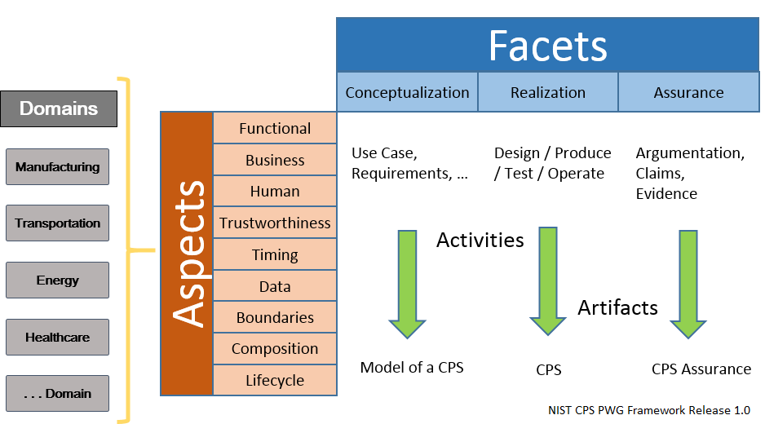
CPS Framework
Notes:
Functional: work as expected functionality
Business: cost
Human: new
Trustworthiness: the hardware (fabraicated somewhere else)/software module (developed somewhere else), can you trust them?
Timing: real time constraint
Data:
Boundary: within a system, or a connected system
Composition: Individual components work fine. When they are integrated together, problems might arise.
Lifecycle:

Slide 52
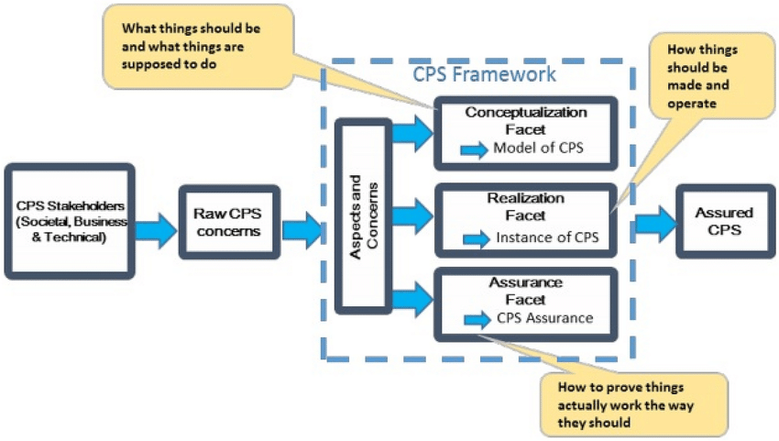
CPS Framework
Notes:
Modeling is the process of gaining a deeper understanding of a system through imitation. Models specify what a system does.
Design is the structured creation of artifacts. It specifies how
a system does what it does. This includes optimization.
Analysis is the process of gaining a deeper understanding of
a system through dissection. It specifies why a system does
what it does (or fails to do what a model says it should do).

Slide 53
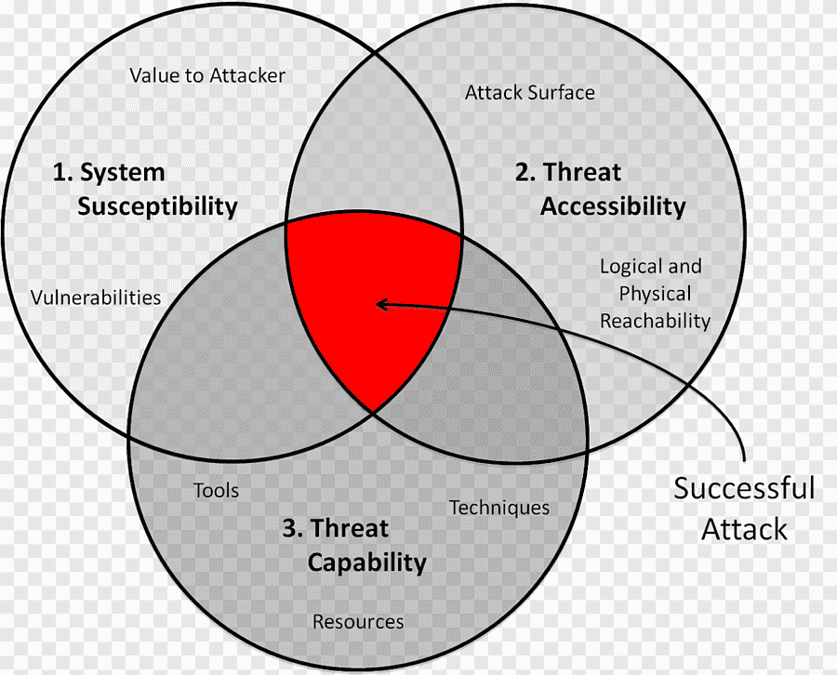
Methodology initially developed at AFAR
Three Tenets-reduce a System’s vulnerability by:
Focus on what is critical – reduce the number of potential susceptibility points
Move It 'Out of Band' – make the critical pieces less accessible (or inaccessible)
Detect, React, Adapt – deny the threat the ability to do harm (get inside the adversary’s OODA loop)
The Methodology is sound – now need to research & develop the processes, tools & technologies to efficiently implement the methodology
Notes:
Unique, cost effective Methodology initially developed at AFIT
Total system approach, focused on mission assurance, using a unique,validated analysis methodology

Slide 54
The Solutions

Slide 55
The Solutions
The Linux kernel runs in an area of system memory called the kernel space
Regular user applications run in an area of system memory called user space
A hard boundary between these two spaces prevents
User applications from accessing memory and resources required by the Linux kernel
Linux kernel from crashing due to badly written user code
Interfering one user’s applications with another

Slide 56
The Solutions
Auto manufacturers need to recognize this security flaw in the CAM if they are using wireless ECU communication
Controller authentication
Only valid controllers can communicate on the CAN
Encrypted communication
Must be high performance, so use symmetric key
Distribute symmetric key using asymmetric encryption during authentication
Firewall
Restrict a components commands to only those essential to its function

Slide 57
Risk Management
Much broader than information security
Identify
Analyse
Evaluate
Treat
Risk: Probability of Something harmful to happen
Notes:
The key risk management component of the IT security process is critical, since without it there is a significant chance that resources will not be deployed where most effective. The result will be that some risks are not addressed, leaving the organization vulnerable, whilst other safeguards may be deployed without sufficient justification, wasting time and money. Ideally every single organizational asset is examined, and every conceivable risk to it evaluated. If a risk is judged to be too great, then appropriate remedial controls are deployed to reduce the risk to an acceptable level. In practice this is clearly impossible.
Given the very wide range of organizations there clearly needs to be a range of alternatives available in performing this process. There are a range of formal standards which detail suitable IT security risk assessment processes, including [ISO13335] and [NIST02]. In particular, [ISO13335] recognizes four approaches to identifying and mitigating risks to an organization's IT infrastructure: baseline approach, informal approach, detailed risk analysis, combined approach.
The choice among these will be determined by the resources available to the organization, and from an initial high-level risk analysis that considers how valuable the IT systems are, and how critical to the organization’s business objectives. Legal and regulatory constraints may also require specific approaches. This information should be determined when developing the organization’s IT security objectives, strategies and policies.

Slide 58
Security Risk Assessment
critical component of process
else may have vulnerabilities or waste money
ideally examine every asset vs risk
not feasible in practice
choose one of possible alternatives based on organization’s resources and risk profile
baseline
informal
formal
combined
Notes:
The key risk management component of the IT security process is critical, since without it there is a significant chance that resources will not be deployed where most effective. The result will be that some risks are not addressed, leaving the organization vulnerable, whilst other safeguards may be deployed without sufficient justification, wasting time and money. Ideally every single organizational asset is examined, and every conceivable risk to it evaluated. If a risk is judged to be too great, then appropriate remedial controls are deployed to reduce the risk to an acceptable level. In practice this is clearly impossible.
Given the very wide range of organizations there clearly needs to be a range of alternatives available in performing this process. There are a range of formal standards which detail suitable IT security risk assessment processes, including [ISO13335] and [NIST02]. In particular, [ISO13335] recognizes four approaches to identifying and mitigating risks to an organization's IT infrastructure: baseline approach, informal approach, detailed risk analysis, combined approach.
The choice among these will be determined by the resources available to the organization, and from an initial high-level risk analysis that considers how valuable the IT systems are, and how critical to the organization’s business objectives. Legal and regulatory constraints may also require specific approaches. This information should be determined when developing the organization’s IT security objectives, strategies and policies.

Slide 59
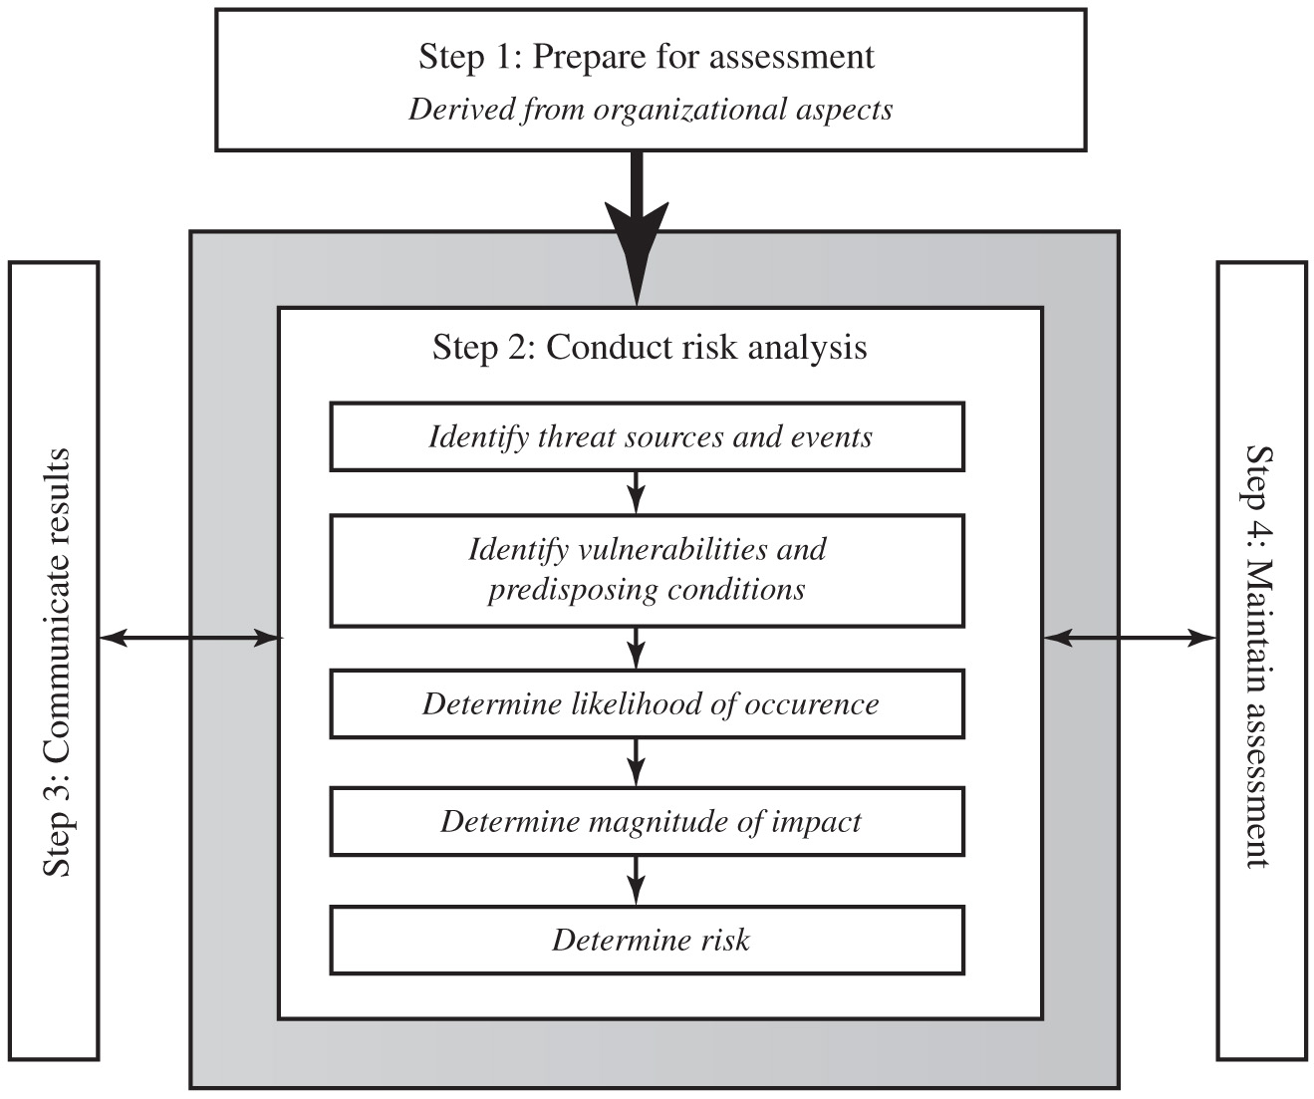
Figure 14.3 Risk Assessment Process
Notes:
A number of national and international standards document the expected formal risk analysis approach. These include ISO 27005, ISO 31000, NIST SP 800-30, and [SASN13]. This approach is often mandated by government organizations and associated businesses. These standards all broadly agree on the process used. Figure 14.3 (reproduced from figure 5 in NIST SP 800-30) illustrates a typical process used.
The steps are as follows. Step 1. Prepare for assessment, derived from organizational aspects. Step 2. Conduct risk analysis. Identify threat sources and events. Identify vulnerabilities and predisposing conditions. Determine likelihood of occurrence. Determine magnitude of impact. Determine risk. Step 3. Communicate results. Step 4. Maintain assessment.

Slide 60
Terminology
Notes:
The next step in the process is to identify the threats or risks the assets are exposed to. It is worth commenting on the terminology used here. The terms “threat” and “risk”, whilst having distinct meanings, are often used interchangeably in this context. There is considerable variation in the definitions of these terms, as seen in the range of definitions provided in the cited standards. [ISO13335] includes the definitions shown here. The relationship between these and other security concepts is illustrated in Figure 1.2 of the text. It shows the central term risk results from a threat exploiting vulnerabilities in assets which causes loss of value to the organization.

Slide 61
Asset Identification
identify assets
“anything which needs to be protected”
of value to organization to meet its objectives
tangible or intangible
in practice try to identify significant assets
Assets:
Hardware
Software
Information (Intellectual Property)
draw on expertise of people in relevant areas of organization to identify key assets
identify and interview such personnel
see checklists in various standards
Notes:
The last component of this first step in the risk assessment is to identify the assets to examine. This directly addresses the first of the three fundamental questions “What assets do we need to protect?”. An asset is “anything which needs to be protected” because it has value to the organization and contributes to the successful attainment of the organization’s objectives, and may be either tangible or intangible. It includes computer and communications hardware infrastructure, software including applications, information/data held on these systems, the documentation on these systems, and the people who manage and maintain these systems. Within the boundaries identified for the risk assessment, these assets need to be identified, and their value to the organization assessed. It is important to emphasize again, that whilst the ideal is to consider every conceivable asset, in practice this is not possible. Rather the goal here is to identify all assets that contribute significantly to attaining the organization’s objectives, and whose compromise or loss would seriously impact on the organizations operation.
Whilst the risk assessment process is most likely being managed by security experts, they will not necessarily have a high degree of familiarity with the organization’s operation and structures. Thus they need to draw on the expertise of the people in the relevant areas of the organization to identify key assets and their value to the organization. A key element of this process step is identifying and interviewing such personnel. Many of the standards listed previously include checklists of types of assets and suggestions for mechanisms for gathering the necessary information. These should be consulted and used. The outcome of this step should be a list of assets, with brief descriptions of their use by, and value to, the organization.

Slide 62
Analyze Risks
Likelihood: likelihood of occurrence of each identified threat to asset given existing controls
Attacker skills
Motivation
Difficulty
Impact: specify consequence should threat occur
Effects on Confidentiality, Integrity, or Availability
Cost of Asset
hence derive overall risk rating for each threat
risk = probability threat occurs * cost to organization (Quantative)
in practice very hard to determine exactly
use qualitative not quantitative, ratings for each
Notes:
The next step is to to identify and categorize the risks to assets that threaten the regular operations of the organization, and to provide information to management to help them evaluate these risks and determine how best to treat them. Risk analysis involves firstly specifying the likelihood of occurrence of each identified threat to an asset, in the context of any existing controls (management, operational and technical processes and procedures that act to reduce the exposure of the organization to some risks, by reducing the ability of a threat source to exploit some vulnerabilities). Next the consequence to the organization is determined, should that threat eventuate. Lastly this information is combined to derive an overall risk rating for each threat. The ideal would be to specify the likelihood as a probability value, and the consequence as a monetary cost to the organization should it occur. The resulting risk is then simply given as:
Risk = Probability threat occurs x Cost to organization
This can be directly equated to the value the threatened asset has for the organization, and hence specify what level of expenditure is reasonable to reduce the probability of its occurrence to an acceptable level. Unfortunately it is often extremely hard to determine accurate probabilities, realistic cost consequences, or both. This is particularly true of intangible assets, like the loss of confidentiality of a trade secret for example. Hence most risk analyses use qualitative, rather than quantitative, ratings for both these items. The goal is then to order the resulting risks to help determine which need to be most urgently treated, rather than give them an absolute value.

Slide 63
Determine Likelihood
Notes:
Having identified existing controls, the likelihood that each identified threat could occur and cause harm to some asset needs to be specified. The risk analyst takes the descriptive asset and threat/vulnerability details from the preceding steps in this process, and in the light of the organizations overall risk environment and existing controls, decides the appropriate rating. This estimation relates to the likelihood of the specified threat exploiting one or more vulnerabilities to an asset or group of assets, which results in harm being caused to the organization. The likelihood is typically described qualitatively, using values and descriptions such as those shown here from Table 16.2 in the text. Whilst the various risk assessment standards all suggest tables similar to these, there is considerable variation in their detail.
The specified likelihood needs to be realistic. In particular, a rating of Likely or higher suggests that this threat has occurred sometime previously. This means past history provides supporting evidence for its specification. If this is not the case, then specifying such a value would need to be justified on the basis of a significantly changed threat environment, a change in the IT systems which has weakened it’s security, or some other rationale for its anticipated likely occurrence. In contrast, the Unlikely and Rare ratings can be very hard to quantify. They are an indication that the threat is of concern, but knowing whether it could potentially occur is difficult to specify. Typically such threats would only be considered if the consequences to the organization of their occurrence are so severe that they have to be considered, even if extremely improbable.

Slide 64
Determine Consequence
Notes:
The analyst must then specify the consequence of a specific threat eventuating, which is distinct from, and not related to, the likelihood of the threat occurring. Rather, consequence specification indicates the impact on the organization should the particular threat in question actually eventuate. Even if a threat is regarded as rare or unlikely, if the organization would suffer severe consequence should it occur, then it clearly poses a risk to the organization. Hence, appropriate responses must be considered. A qualitative descriptive value, such as those shown here from Table 16.3 in the text, is typically used to describe the consequence. As with the likelihood ratings, there is likely to be some uncertainty as to the best rating to use.
This determination should be based upon the judgment of the asset’s owners, and the organization’s management, rather than the opinion of the risk analyst. This is in contrast with the likelihood determination. The specified consequence needs to be realistic. It must relate to the impact on the organization as a whole should this specific threat eventuate. It is not just the impact on the affected system. It is possible that a particular system (a server in one location for example) might be completely destroyed in a fire. However, the impact on the organization could vary from it being a minor inconvenience (the server was in a branch office, and all data was replicated elsewhere), to a major disaster (the server had the sole copy of all customer and financial records for a small business). As with the likelihood ratings, the consequence ratings must be determined knowing the organization’s current practices and arrangements. In particular the organization’s existing backup, disaster recovery, and contingency planning, or lack thereof, will influence the choice of rating.

Slide 65
Determine Resultant Risk
Consequences
Likelihood
Doomsday
Catastrophic
Major
Moderate
Minor
Insignificant
Almost
E
E
E
E
H
H
Certain
Likely
E
E
E
H
H
M
Possible
E
E
E
H
M
L
Unlikely
E
E
H
M
L
L
Rare
E
H
H
M
L
L
Risk Level
Description
Extreme (E)
Will require detailed r
esearch and management planning at an
executive/director level. Ongoing planning and monitoring will be required
with regular reviews. Substantial adjustment of controls to manage the
risk are expected, with costs possibly exceeding original forecasts.
H
igh (H)
Requires management attention, but management and planning can be left
to senior project or team leaders. Ongoing planning and monitoring with
regular reviews are likely, though adjustment of controls are likely to be
met from within existing resources
Medium (M)
Can be managed by existing specific monitoring and response procedures.
Management by employees is suitable with appropriate monitoring and
reviews.
Low (L)
Can be managed through routine procedures.
Hardware Integrity:Low: Fewer possible attacks, lower consequences, relatively easy to safeguards
Software integrity: High: More possible attacks, higher consequences, relatively harder to safeguards
Qualitative: Low, Medium, High.
Quantitative: 1- 5, 1-10, 1-100 (Nuclear Power Plant)
Notes:
Once the likelihood and consequence of each specific threat have been identified, a final level of risk can be assigned. This is typically determined using a table that maps these values to a risk level, such as those shown in Table 16.4 from the text. This table details the risk level assigned to each combination. Such a table provides the qualitative equivalent of performing the ideal risk calculation using quantitative values. It also indicates the interpretation of these assigned levels.

Slide 66
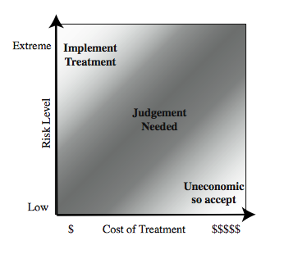
Risk Treatment
Judgements: Justfiable
Notes:
Management may decide that for business reasons, given an overall view of the organization, some risks with lower levels should be treated ahead of other risks. This is both a reflection of limitations in the risk analysis process in the range of ratings available and their interpretation, and management’s perspective of the organization as a whole. Figure 16.5 from the text shows a range of possibilities for costs verses levels of risk. If the cost of treatment is high, but the risk is low, then it is usually uneconomic to proceed with such treatment. Alternatively, where the risk is high, and the cost comparatively low, then clearly treatment should occur. The most difficult area occurs between these extremes. This is where management must make a business decision about the most effective use of their available resources. This decision usually requires a more detailed investigation of the treatment options.

Slide 67
Risk Treatment Alternatives
risk acceptance: accept risk (perhaps because of excessive cost of risk treatment)
risk avoidance: do not proceed with the activity that causes the risk (loss of convenience)
risk transfer: buy insurance; outsource
reduce consequence: modify the uses of an asset to reduce risk impact (e.g., offsite backup)
reduce likelihood: implement suitable controls
Notes:
There are five broad alternatives available to management for treating identified risks:
risk acceptance: of a risk level greater than normal for business reasons, typically due to excessive cost or time needed to treat the risk. Management must then accept responsibility for the consequences to the organization should the risk eventuate.
risk avoidance: not proceeding with the activity or system which creates this risk, resulting in loss of convenience or ability to perform some function that is useful to the organization, but traded off against the reduced risk profile.
risk transferal: sharing responsibility for the risk with a third-party. This is typically achieved by taking out insurance against the risk occurring, by entering into a contract with another organization, or by using partnership or joint venture structures to share the risks and costs should it eventuate.
reduce the consequence: by modifying the structure or use of the assets at risk to reduce the impact on the organization should the risk occur. This could be achieved by implementing controls to enable the organization to quickly recover should the risk occur. Examples include implementing an offsite backup process, developing a disaster recovery plan, or arranging for data and processing to be replicated
reduce the likelihood: by implementing suitable controls to lower the chance of the vulnerability being exploited. These could include technical or administrative controls such as deploying firewalls and access tokens, or procedures such as password complexity and change policies. Such controls aim to improve the security of the asset, making it harder for an attack to succeed by reducing the vulnerability of the asset.
If either of the last two options is chosen, then possible treatment controls need to be selected, and their cost effectiveness evaluated. We discuss this in the text chapter 17.

Slide 68
Risk Management – Iterative Process
Context → Assessment -- >Treatment → Acceptance → Context…
Establish the context
Risk Assessment
Identify
Measure
Prioritise
Treatment : Treat the risk
Reduce
Avoid
Share
Accept (Not enough resources)
Risk Communication: (to the management and senior management)
Risks
Security Controls
Monitor and Review – Iterative Process
Notes:
The key risk management component of the IT security process is critical, since without it there is a significant chance that resources will not be deployed where most effective. The result will be that some risks are not addressed, leaving the organization vulnerable, whilst other safeguards may be deployed without sufficient justification, wasting time and money. Ideally every single organizational asset is examined, and every conceivable risk to it evaluated. If a risk is judged to be too great, then appropriate remedial controls are deployed to reduce the risk to an acceptable level. In practice this is clearly impossible.
Given the very wide range of organizations there clearly needs to be a range of alternatives available in performing this process. There are a range of formal standards which detail suitable IT security risk assessment processes, including [ISO13335] and [NIST02]. In particular, [ISO13335] recognizes four approaches to identifying and mitigating risks to an organization's IT infrastructure: baseline approach, informal approach, detailed risk analysis, combined approach.
The choice among these will be determined by the resources available to the organization, and from an initial high-level risk analysis that considers how valuable the IT systems are, and how critical to the organization’s business objectives. Legal and regulatory constraints may also require specific approaches. This information should be determined when developing the organization’s IT security objectives, strategies and policies.

Slide 69
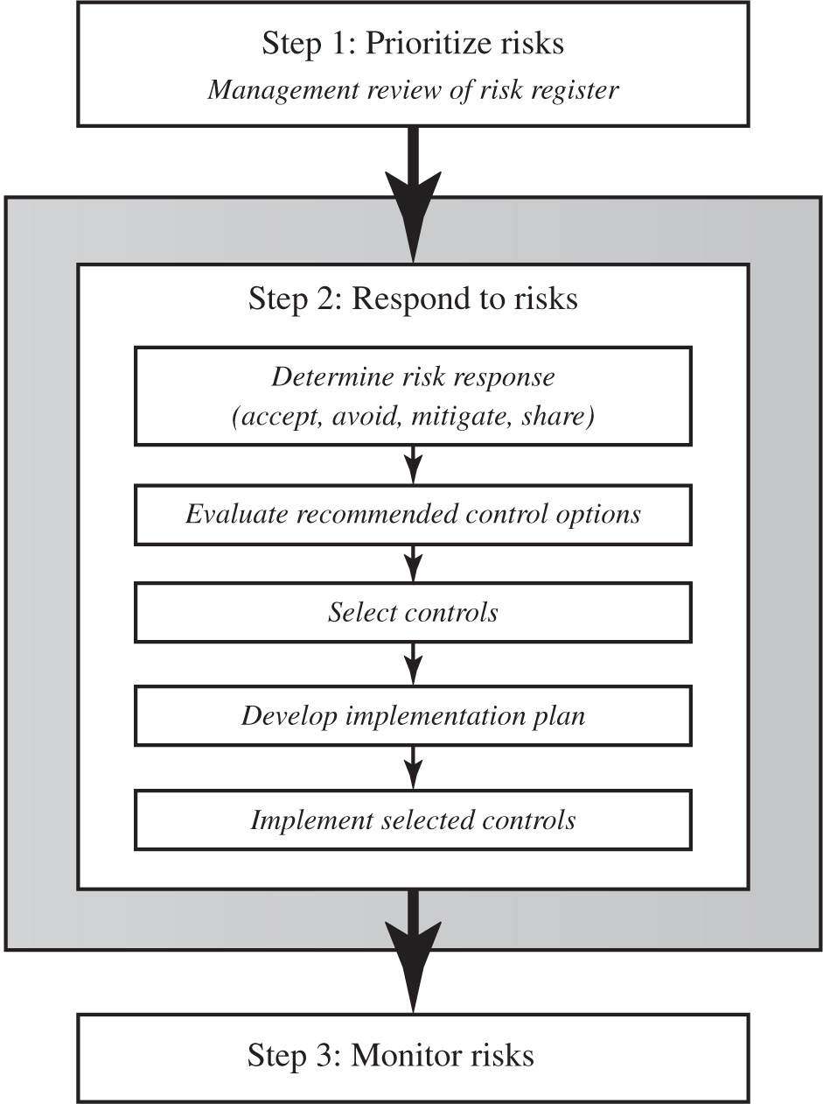
Figure 15.1 I T Security Management Controls and Implementation
Notes:
We introduced the IT security management process in Chapter 14, illustrated by Figure 14.1. Chapter 14 focused on the earlier stages of this process. In this chapter, we focus on the latter stages, which include selecting controls, developing an implementation plan, and the follow-up monitoring of the plan’s implementation. We broadly follow the guidance provided in NIST SP 800-39 (Managing Information Security Risk: Organization, Mission, and Information System View , March 2011), which was developed by NIST in 2011 as the flagship document for providing guidance for an integrated, organization-wide program for managing information security risk, in response to FISMA. A broad summary of these steps is given in Figure 15.1. We will discuss each of these in turn.
The illustration involves the steps as follows.
Step 1. Prioritize risks, Management review of risk register.
Step 2. Respond to risks. Step 2 involves the following.
• Determine risk response, accept, avoid, mitigate, share
• Evaluate recommended control options
• Select controls
• Develop implementation plan
• Implement selected controls
Step 3. Monitor risks. Arrows extend from one step to the other.

Slide 70
Control Classifications
Management controls
Focus on security policies, planning, guidelines, and standards that influence the selection of operational and technical controls to reduce the risk of loss and to protect the organization’s mission
These controls refer to issues that management needs to address
Operational controls
Address the correct implementation and use of security policies and standards, ensuring consistency in security operations and correcting identified operational deficiencies
These controls relate to mechanisms and procedures that are primarily implemented by people rather than systems
They are used to improve the security of a system or group of systems
Technical controls
Involve the correct use of hardware and software security capabilities in systems
These range from simple to complex measures that work together to secure critical and sensitive data, information, and I T systems functions
Notes:
Some controls address multiple risks at the same time, and selecting such controls can be very cost effective. Controls can be classified as belonging to one of the following classes (although some controls include features from several of these):
• Management controls: Focus on security policies, planning, guidelines, and standards that influence the selection of operational and technical controls to reduce the risk of loss and to protect the organization’s mission. These controls refer to issues that management needs to address. We discuss a number of these in Chapters 14 and 15.
• Operational controls: Address the correct implementation and use of security policies and standards, ensuring consistency in security operations and correcting identified operational deficiencies. These controls relate to mechanisms and procedures that are primarily implemented by people rather than systems. They are used to improve the security of a system or group of systems. We will discuss some of these in Chapters 16 and 17.
• Technical controls: Involve the correct use of hardware and software security capabilities in systems. These range from simple to complex measures that work together to secure critical and sensitive data, information, and IT systems functions.

Slide 71
Security Controls
Security Requirement Families
Family | Family
Access Control | Media Protection
Awareness and Training | Personnel Security
Audit and Accountability | Physical Protection
Configuration Management | Risk Assessment
Identification and Authentication | Security Assessment
Incident Response | System and Communications Protection
Maintenance | System and Information Integrity

Slide 72
Incident Management – ISO 27002
Report – Capture All relevant information
Investigation
Assessment
Corrections
Review

Slide 73


Web Security
The World Wide Web (web)
WWW is everywhere
Banking, shopping, education, communicating, news, …
A lot of applications to support WWW
Browsers
Servers

Slide 74
Web Security Issues
Secure communications between client & server
HTTPS (HTTP over SSL/TLS)
User authentication & session management
Cookies & other methods
Active contents from different websites
Protecting resources maintained by browsers
Web application security
Web site authentication (e.g., anti-phishing)
Privacy concerns

Slide 75
Use Cookies to Store State Info
Cookies
A cookie is a name/value pair created by a website to store information on your computer
Enters form data
Server
Browser
Response + cookies
Request + cookies
Server
Browser
Returns data
Http is stateless protocol; cookies add state

Slide 76
Same Origin Policy (SOP)
The basic security model enforced in the browser
SoP isolates the scripts and resources downloaded from different origins
E.g., evil.org scripts cannot access bank.com resources
Use origin as the security principal
Note that the concept of user accounts does not apply here as security principals
Origin = domain name + protocol + port
all three must be equal for origin to be considered the same
Same-origin policy also applies to XMLHttpRequest

Slide 77
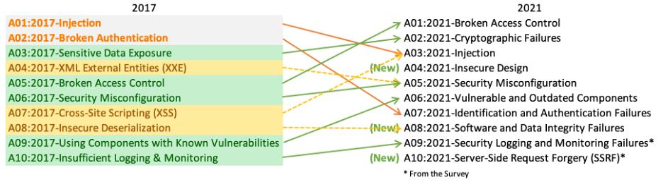
OWASP Top 10 Web Application Security Risks
OWASP: Open Web Application Security Project

Slide 78
Three Top Web Site Vulnerabilities
XSS – Cross-site scripting
Bad web site sends innocent victim a script that steals information from an honest web site
CSRF – Cross-site request forgery
Bad web site sends browser request to good web site, using credentials of an innocent victim
SQL Injection
Browser sends malicious input to server
Bad input checking leads to malicious SQL query
Notes:
Root cause of XSS, and CSRF:
Data from untrusted source gets executed!
Data and code are mixed together
Root cause of SQL Injection: Data and code are mixed together.

Slide 79
Types of XSS
Types of XSS:
Reflected XSS: A reflected XSS vulnerability happens when the user input from a URL or POST data is reflected on the page without being stored.
Persistent or Stored XSS: Stored Cross-site scripting vulnerabilities happens when the payload is saved, for example in a database and then is executed when a user opens the page. Stored cross-site scripting is very dangerous for a number of reasons
DOM-based XSS: The DOM Based XSS vulnerability happens in the DOM (Document Object Model) instead of part of the HTML.

Slide 80
Defenses of XSS - Input Data Validation & Filtering
Main problem:
Input checking is difficult --- many ways to inject scripts into HTML.
Preprocess input from user before echoing it
PHP: htmlspecialchars(string)
& → &amp; " → &quot; ' → &#039;
< → &lt; > → &gt;
htmlspecialchars( "<a href='test'>Test</a>", ENT_QUOTES);
Outputs: &lt;a href=&#039;test&#039;&gt;Test&lt;/a&gt;
Notes:
XSS defense: CSP (Content Security Policy)

Slide 81
Cross-Site Request Forgery (CSRF)
When a web server is designed to receive a request from a client without any mechanism for verifying that it was intentionally sent, then it might be possible for an attacker to trick a client into making an unintentional request to the web server which will be treated as an authentic request. This can be done via a URL, image load, XML,Http Request, etc. and can result in exposure of data or unintended code execution.

Slide 82
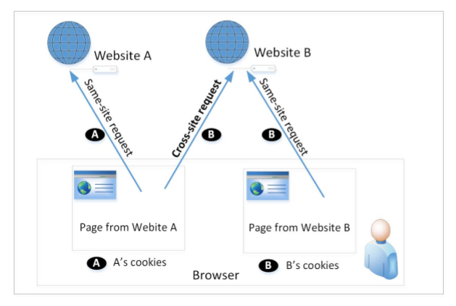
Cross-Site Requests and Its Problems
When a page from a website sends an HTTP request back to the website, it is called same-site request.
If a request is sent to a different website, it is called cross-site request because the where the page comes from and where the request goes are different.
Eg : A webpage (not Facebook) can include a Facebook link, so when users click on the link, HTTP request is sent to Facebook.

Slide 83
Defenses - Check CSRF Token
Any state changing operation requires a secure random token (e.g., CSRF token) to prevent CSRF attacks
Characteristics of a CSRF Token
Unique per user session
Large random value
Generated by a cryptographically secure random number generator
The CSRF token is added as a hidden field for forms or within the URL if the state changing operation occurs via a GET
The server rejects the requested action if the CSRF token fails validation

Slide 84
Defenses: Referer Header
HTTP header field identifying the address of the web page from where the request is generated.
A server can check whether the request is originated from its own pages or not.
This field reveals part of browsing history causing privacy concern and hence, this field is mostly removed from the header.
The server cannot use this unreliable source.

Slide 85
Defenses: Same-Site Cookies
A special type of cookie in browsers like Chrome and Opera, which provide a special attribute to cookies called SameSite.
This attribute is set by the servers and it tells the browsers whether a cookie should be attached to a cross-site request or not.
Cookies with this attribute are always sent along with same-site requests, but whether they are sent along with cross-site depends on the value of this attribute.
Values
Strict (Not sent along with cross-site requests)
Lax (Sent with cross-site requests)

Slide 86
SQL Injection Attack
Exploit a security vulnerability in an SQL application (e.g., web application)
A specific case of “incomplete mediation”
Targets User Input Handlers
Many web applications take user input from a form
Often this user input is used literally in the construction of a SQL query submitted to a database.
For example: • SELECT productdata FROM table WHERE productname = ‘user input product name’;
A SQL injection attack involves placing SQL statements in the user input

Slide 87
Web Application
One of the most popular Internet applications

Slide 88
Under the Hood
Web Server
Database
User

Slide 89
SQL Injection
Web
Browser (Client)
Enter
Username
&
Password
Web
Server
SELECT *
FROM Users
WHERE user='me' AND pwd='1234'
DB

Slide 90
SQL Injection
Web
Browser (Client)
Enter
Username
&
Password
Web
Server
SELECT *
FROM Users
WHERE user='me' AND pwd='1234'
DB
What if user = “ ' or 1=1 -- ”

Slide 91
Defenses
URL based injection:
Avoid using clear text when coding in SQL.
If your database and webpage are constructed in a way where you can view the data, it’s open to injection. http://mysite.com/listauthordetails.aspx?SSN=172-32-9999
Passwords, and other sensitive information need to be encrypted or hashed
There is no full proof way to defend from injection, but by limiting sensitive information, you can ensure that your information is at least somewhat protected.
Notes:
Root cause of SQL Injection:
Data and code are mixed together.

Slide 92
Defenses
Using prepared statements - separate the data from the query
sending program to the server first
$db->prepare("SELECT * FROM users where id=?");
where the data is substituted by some variable called "placeholder“
Note that the very same query being sent to the server, without any data in it
Then sending the data with the second request, totally separated from the query itself:
$db->execute($data);
It can't alter our program and do any harm

